Slide 1



Uolli
https://github.com/filippocastelli/uolli
Filippo Maria Castelli, MSc
PhD Student @ LENS
European Laboratory for NonLinear Spectroscopy
castelli@lens.unifi.it
Carlo Emilio Montanari, MSc
PhD Student @ UNIBO
carlo.montanari5@unibo.it
A tale of software bugs and fried hardware
Bologna, 06/12/2019

Slide 2


About us
Filippo Maria Castelli, MSc
PHD Student @ LENS (European Laboratory for NonLinear Spectroscopy – Sesto Fiorentino, Italy)
Master’s in Applied Physics @ UNIBO
Bachelor’s in Physics @ UNIPI
Carlo Emilio Montanari, MSc
PhD Student @ UNIBO
Master’s in Applied Physics @ UNIBO
Bachelor’s in Physics @UNIBO

Slide 3
CM-01 Automatic Car
What we wanted it to be:
What we achieved:
Something that actually moves around without catching fire
(it actually catched fire at some point)
Something that can be controlled remotely
Something that somehow perceives its proximities
Mobility: 4 wheels, controlled in pairs
Remote Control:
Wifi: using ESP8266
Infrared remote
Proximity sensing:
HCSR04 ultrasonic range sensor + servo for scanning at 180°
IR range sensor for line following

Slide 4
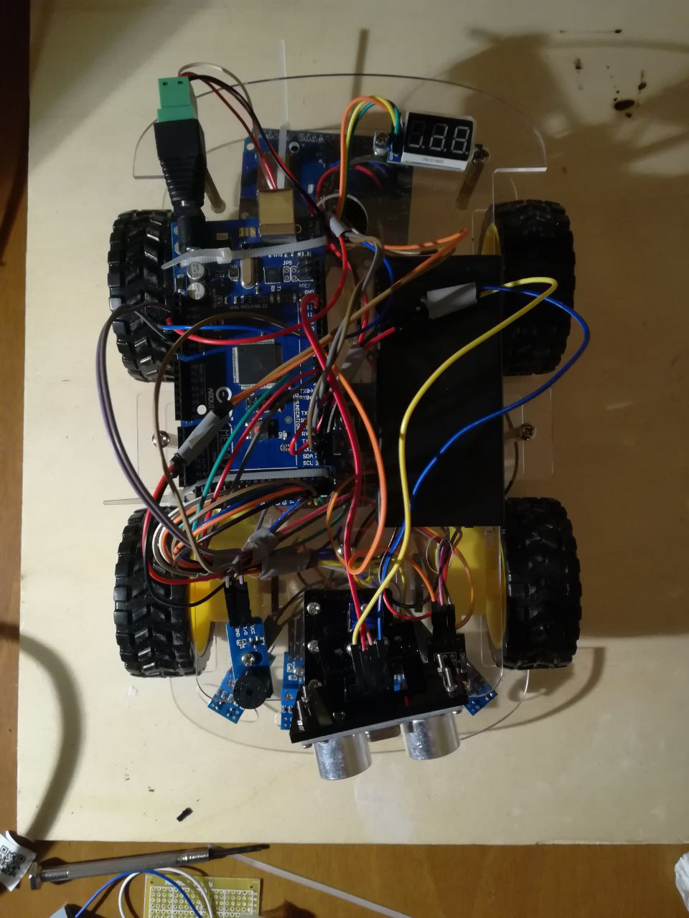
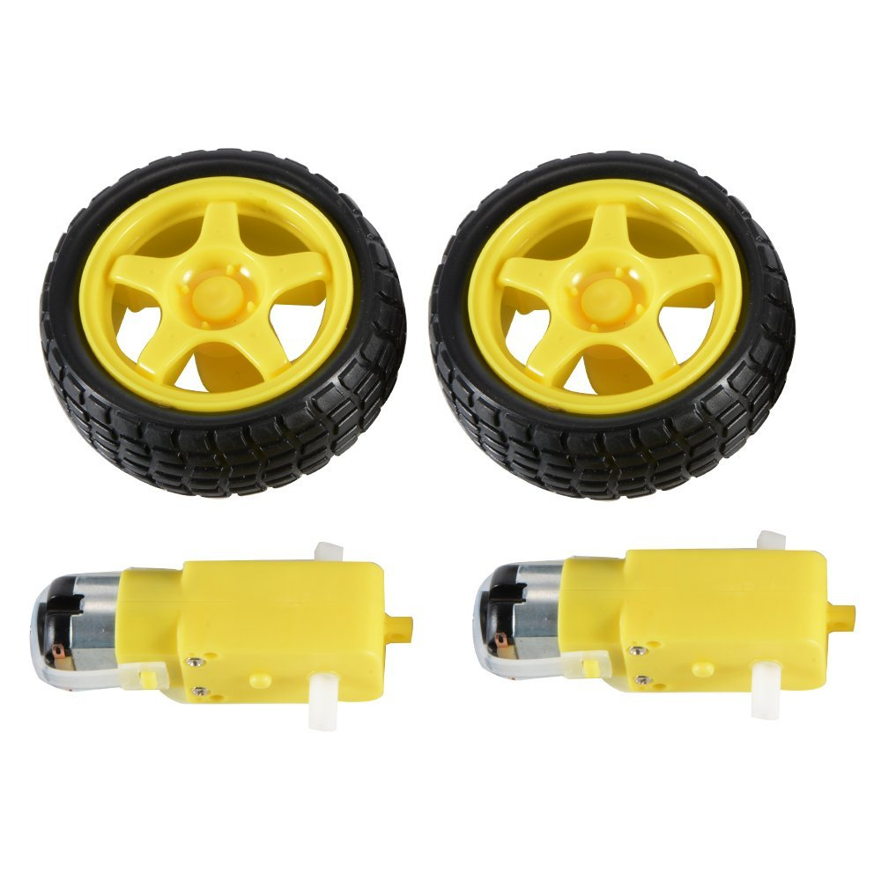
Components:
DC motors + Wheels:
Sold in couples, 5 euros on Amazon, much less on Aliexpress.
Rated 3V – 6V

Slide 5
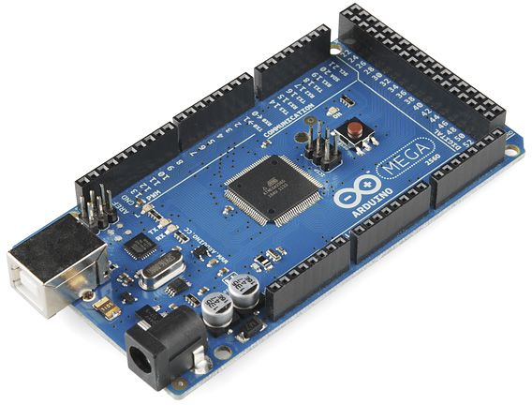
Components:
Arduino Mega 2560 REV3
Has LOTS of GPIO pins, PWM-enabled pins and Analog pins
Multiple Serial interfaces
Same layout of Arduino Uno for shield compatibility

Slide 6
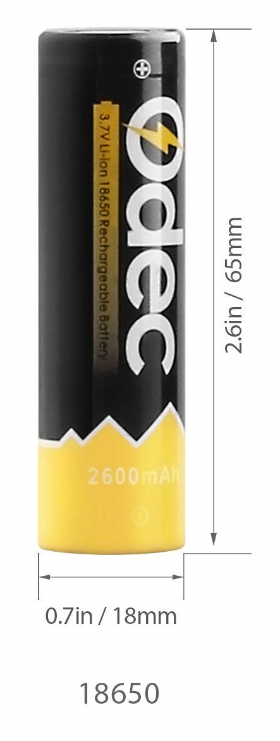
Components:
2x 18650 Li-ion cells
3.6V each (actually almost 4V when fully charged)
!!Faulty battery socket can make them catch fire!!
But as long as you’re careful it should be ok

Slide 7
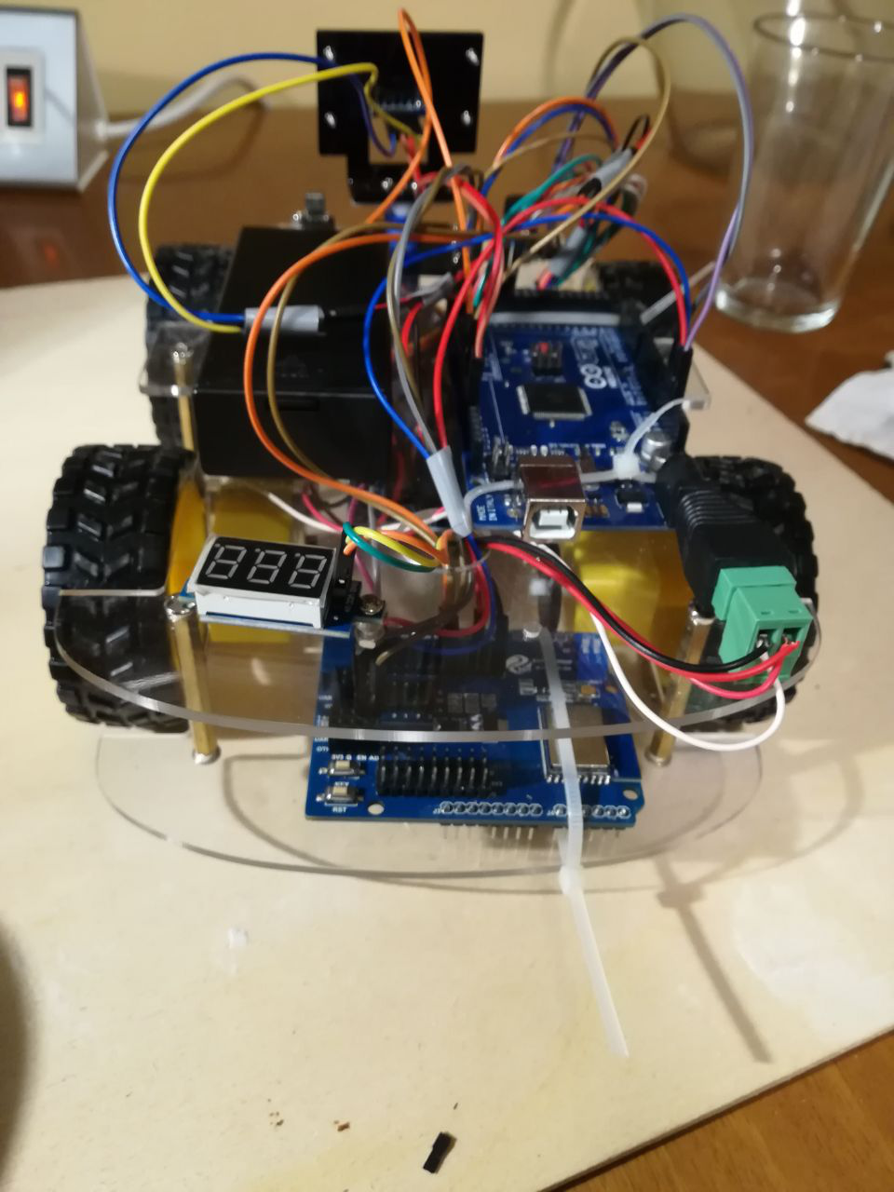
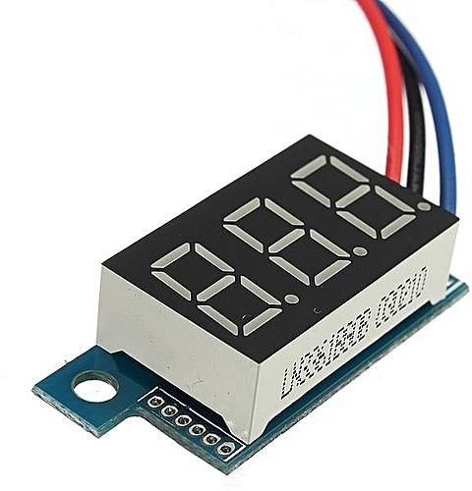
Components:
Voltage meter:
Small
Not very accurate but it’s used only for battery charge status estimation

Slide 8
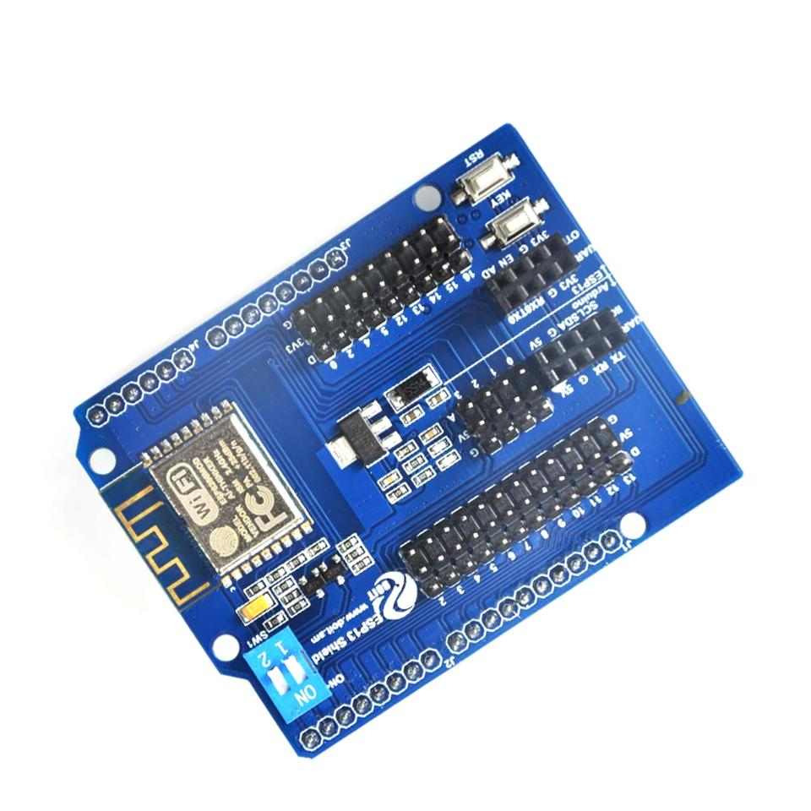
Components:
ESP-13 shield
Carries an ESP-WROOM-02 module based on ESP8266
Not mounted as a shield (going to see why soon)
Cheap compared to other ESP8266 shields
Turns out there’s a reason for that

Slide 9
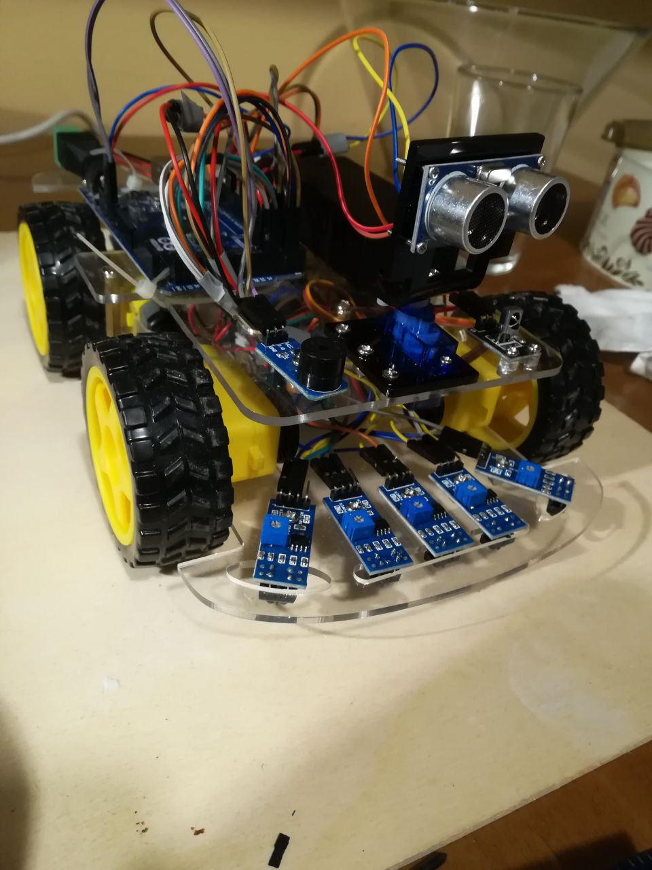
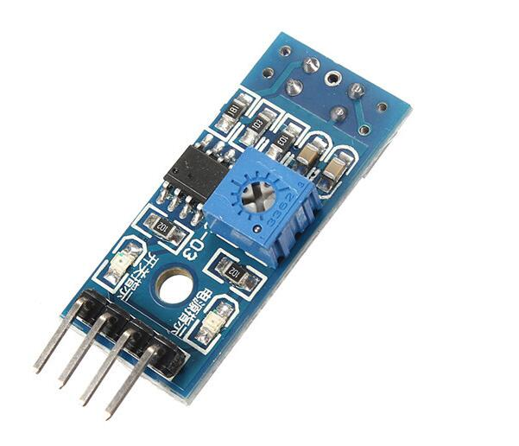
Components:
5X IR proximity sensing modules
Contains an LML393 comparator by ON Semiconductor coupled with a TRT5000 sensor by Vishay
Functioning explained later
Used to let the car follow a black line on the terrain

Slide 10
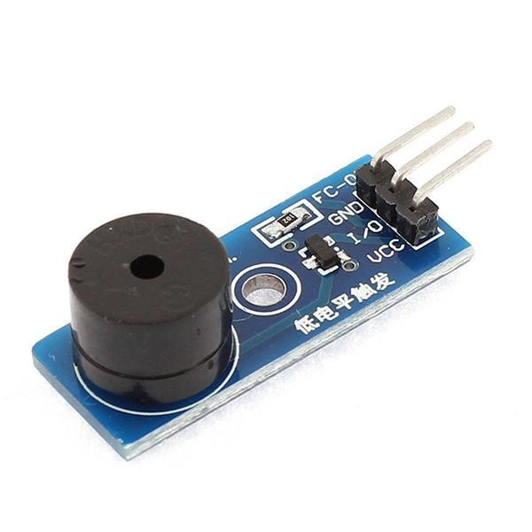
Components:
Piezo Active Buzzer Module
Rated for 3.3V-5V (transistor onboard for power mode switching)
Different from passive buzzer:
Can generate a fixed tone when I/O is HIGH (3.3V)
Con: no frequency control
Pro: doesn’t require a pre-generated waveform

Slide 11
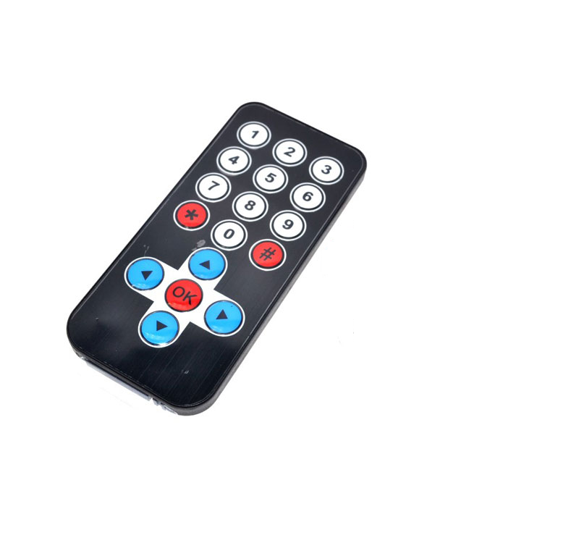
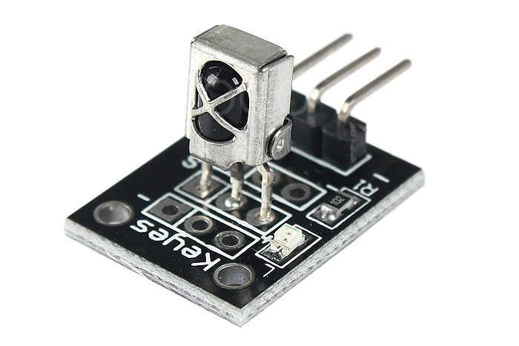
Components:
IR receiver module
Basically a TL1838 Infrared Receiver mounted on a pcb + LED to signal incoming IR message
Allows car to receive signals from any cheap IR transmitter or remote control

Slide 12
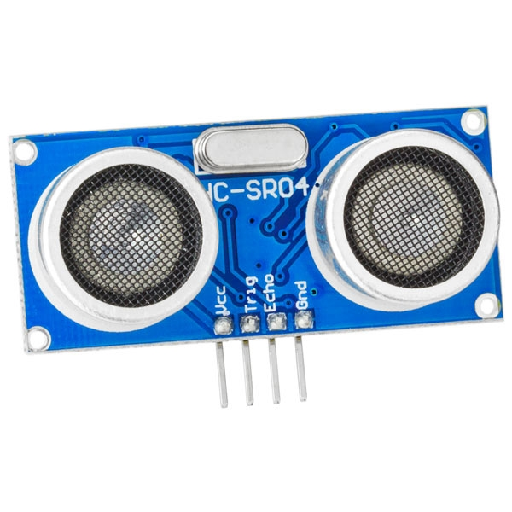
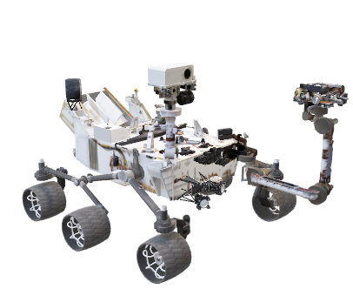
Components:
HCSR04 Ultrasonic Ranging Module:
A couple of transducers, one for transmitting and one for receiving are used to measure an echo delay, thus estimating a linear distance from the sensor itself.
Mounted on a rotating support ot scan multiple directions
Kinda makes the whole thing look like the Curiosity rover

Slide 13
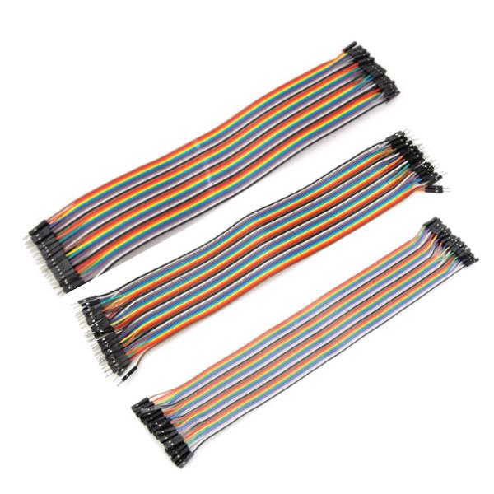
Components:
Jumper Wires
Everything is connected using jumper wires:
MtF
MtM
FtF

Slide 14
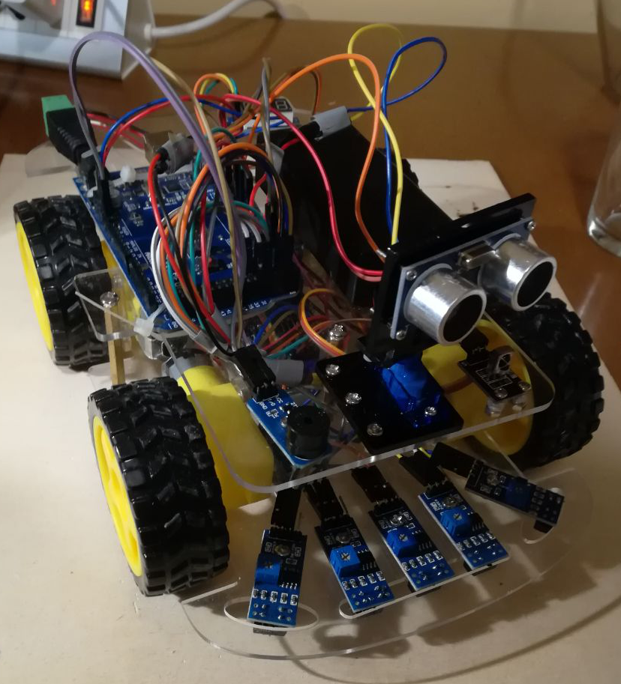
Components:
Piezo Active Buzzer Module
Rated for 3.3V-5V (transistor onboard for power mode switching)
Different from passive buzzers

Slide 15
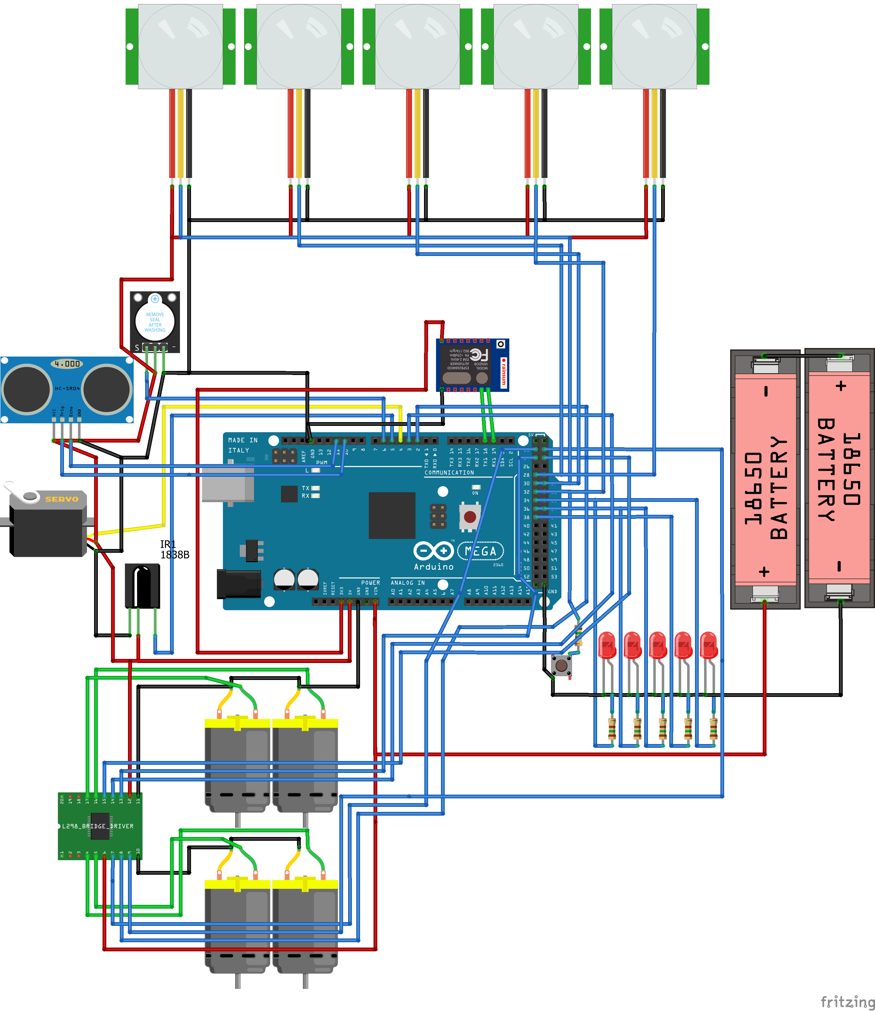
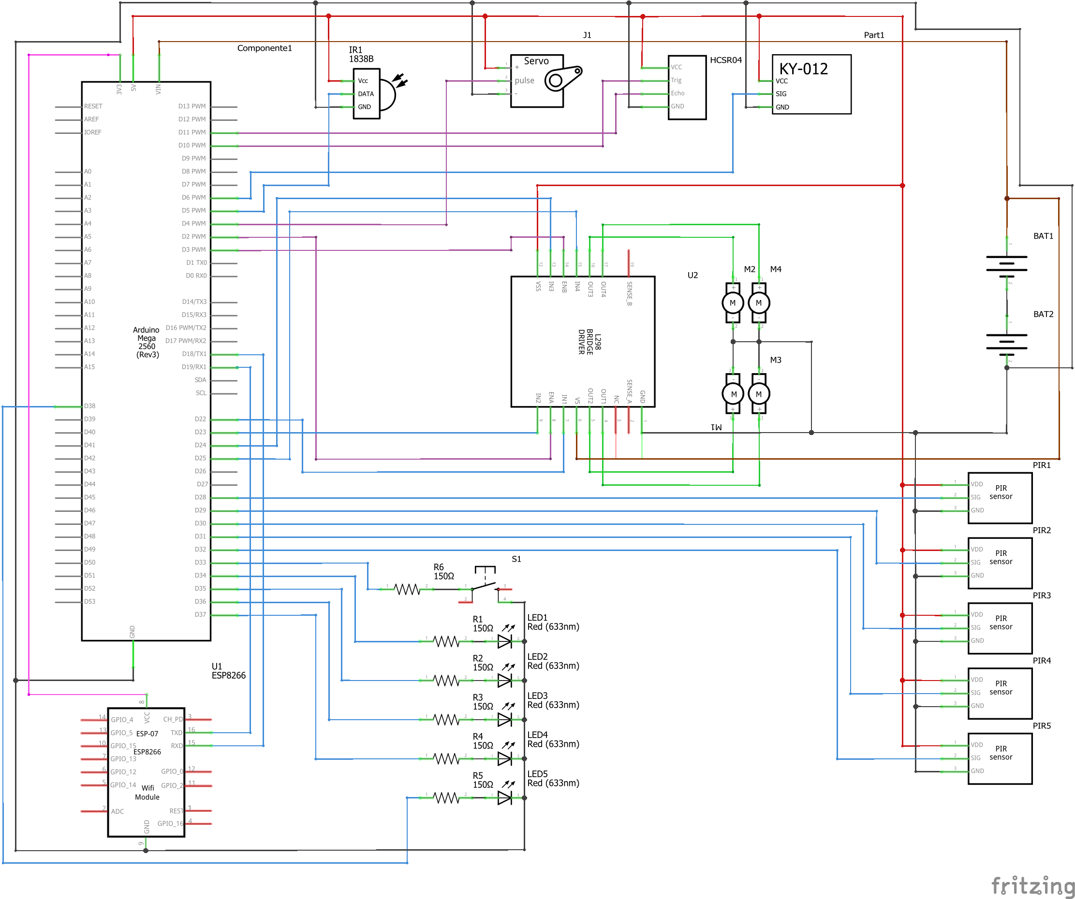
Schematics

Slide 16
IR Tracking Sensor Module
The main idea behind it
An IR led shines on a reflective/absorbing surface. A photoresistor then changes its resistance depending on the received IR radiation and the resulting voltage is then compared by an LM393 dual comparator chip.
Interface A standard IR Tracking Sensor has a 3 Pin interface. VCC and GND for power suppling and a SIG pin for checking if the reflectance is beyond the threshold.
Our IR Tracking Sensor Module has also a fourth pin that allows the user to read the actual voltage signal of the sensor. However, we do not use that pin in our project.

Slide 17
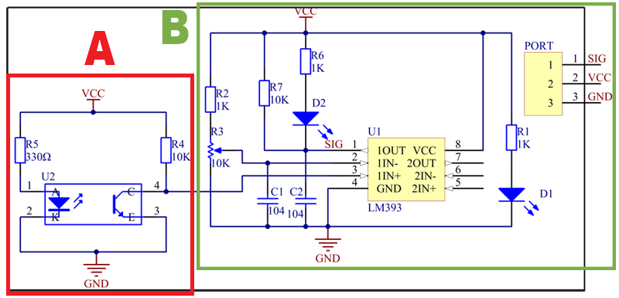
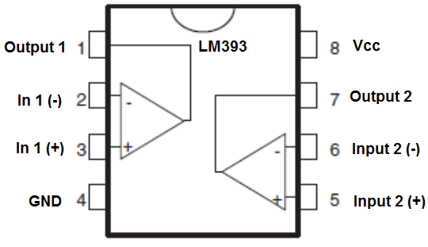
The Schematics:
IR Tracking Sensor Module
Block A contains the U2 module that has the IR led and the Photoresistor.
Block B contains a simple comparing circuit with two status led (D1 and D2) and one potentiometer R3 for manual regulating the threshold of the entire sensor.
D1 indicates whether the sensor is powered up or not. D2 indicates if the signal is positive (SIG=VCC).
LM393 is constituted by 2 standard low offset voltage comparators (only one is used) that returns VCC as +VCC and GND as -VCC, working indeed as a sort of Boolean operator. Capacitors C1 and C2 are placed in order to maintain SIG and 1IN- stable in case of power supplying problems.

Slide 18
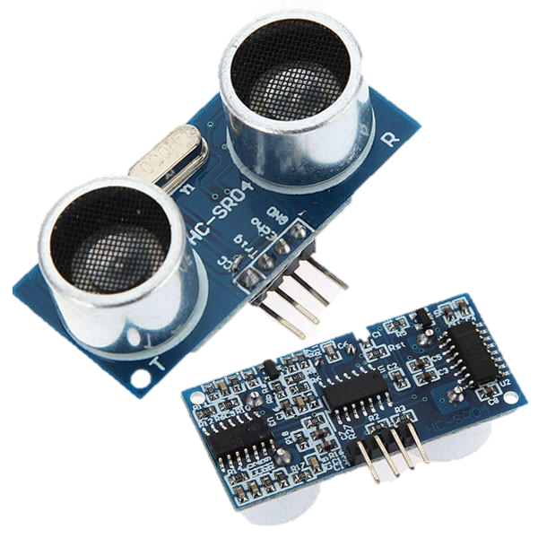
HC-SR04 Echo Locator
Main idea behind it
The sensor emits ultrasonic soundwaves to determine the distance of an object from 2cm to 400cm with a resolution of 0.3cm and a measuring angle of 30 degrees.
Main notes on interface and functionality
The sensor has an interface of 4 pins (VCC, Trig, Echo, GND). Whenever the Trig pin is set on HIGH, the transmitter (left piezo) sends the high-frequency soundwave. Whenever the receiver (right piezo) detects the echo of the soundwave, the Echo pin sets on HIGH.
You can send and read signals to the sensor manually setting up triggers and delays of 5-10μs with a standard Arduino Board.

Slide 19
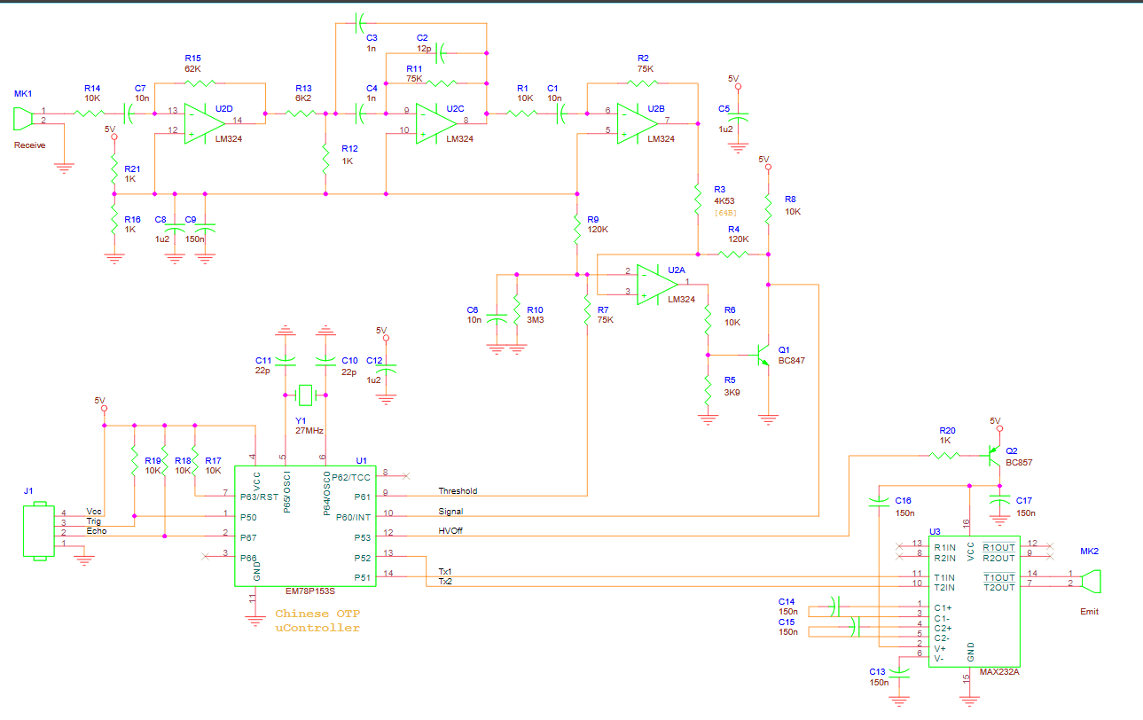
The Schematics:
HC-SR04 Echo Locator
Multiple Feedback
Band-pass Filter

Slide 20
The Schematics:
HC-SR04 Echo Locator
The HC-SR04 unit consists of three main parts: microcontroller, Transmitter and Receiver with associated amplifiers.
Microcontroller U1 (EM78P153):
Interface with Trig an Echo pins
Timing and sending antiphase burst to the transmitter module
Squelch control (i.e. cutting receiver during transmission in order to avoid bogus echoes)
Receiving processed signal by the filtering part as a Rising edge interrupt
Transmitter U3 (MAX232):
Voltage drive to TX transducer from the antiphase TX signals from the micro (U1)
Receiver U2 (LM324):
Quad op-amp (low grade 1MHz unity gain bandwidth device)

Slide 21
More notes
HC-SR04 Echo Locator
The receiver is a chain of three op-amps as small signal stages, the final stage is a variable threshold hysteresis comparator with output switch.
Second stage is a bandpass filter hopefully with tolerances centred around 40 kHz the frequency of the emitted pulses.
Third stage is another amplifier with gain of approximately 10.
First stage is an inverting amplifier of the RX transducer signal, with gain around 5.6 (allowing for tolerances). The output is attenuated with reference to mid-rail.
The last op-amp stage is a variable threshold hysteresis comparator with output switch, the output witch is formed by a transistor in U3 and pullup resistor R17.

Slide 22
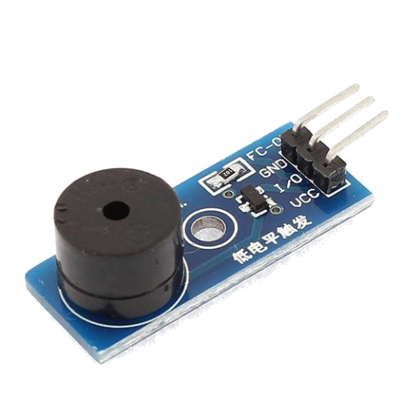
Piezo Active Buzzer
Main idea behind it
Whenever the module is powered and the trigger is set off, a membrane vibrates at a fixed frequency (Active Buzzer) generating a precise sound wave.
Interface
VCC and GND for power supply and I/O for triggering the sound.
If this were a Passive Buzzer, there would be no I/O pin, but we would had to give the precise sound frequency through the VCC and GND pins.

Slide 23
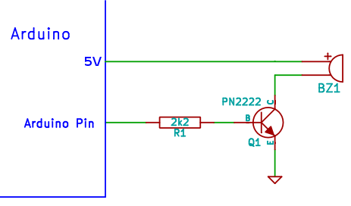
Piezo Active Buzzer – Schematic
Observations on the schematics
The circuit is simply constituted by a resistance and a npn transistor that acts as a switch on the I/O pin.
The Active Buzzer has a built-in oscillating source that will make a precise sound wave when electrified.

Slide 24
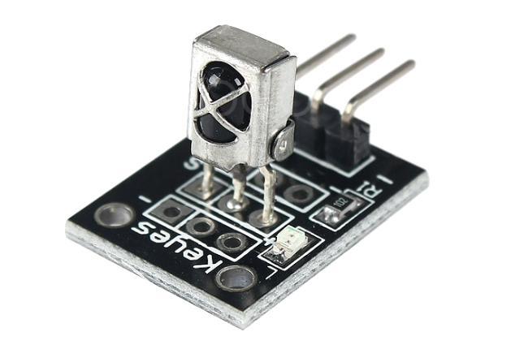
IR Receiver Module
Main idea behind it
A photodiode with integrated demodulator electronics is sealed on a simple PCB with 2 led status and a 3 pin interface.
The photodiode is a TL1838 that works on carrier frequencies of 35-40KHz
Interface
VCC and GND for power supply and SIG for measuring the IR signals recieved.

Slide 25
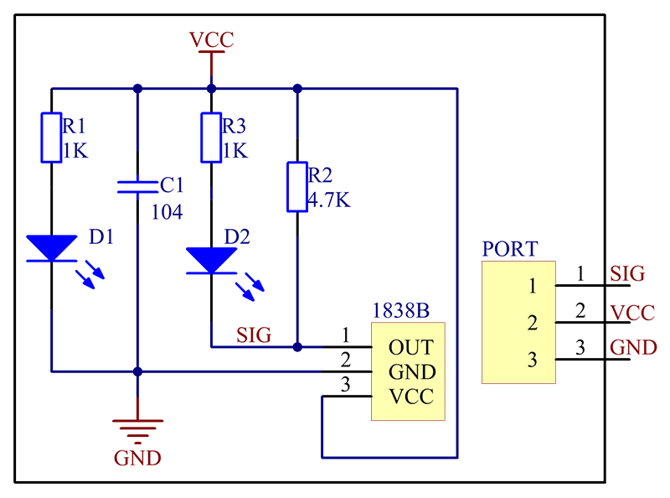
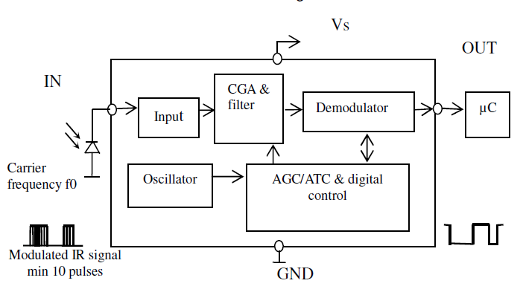
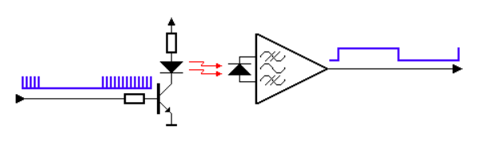
IR (~300GHz) Receiver Module
The Schematics:
Observations on the schematics
The interface on the PCB is a simple wrapping circuit with a power status led (D1), a SIG status led (D2) and a capacitor for power stability (C1).
Remarks on the TL1838
The component has all the elements for receiving 35-40KHz modulated signals in intervals of 600μs. Unfortunately, we did not find the precise schematics of the component but only black-box schemes of its functioning.

Slide 26
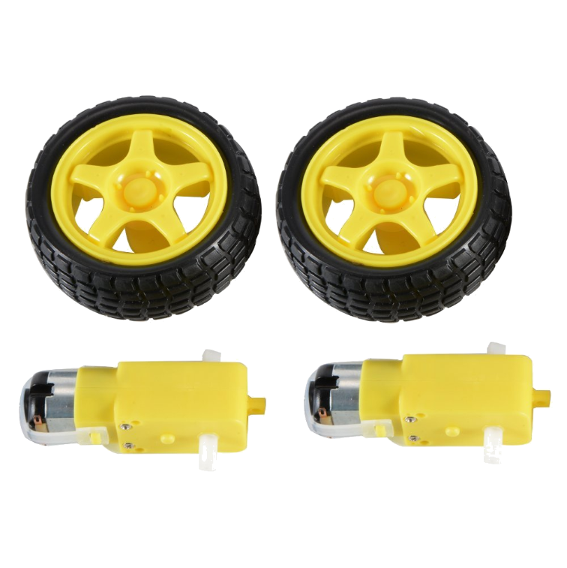
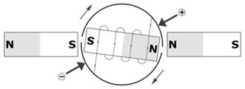
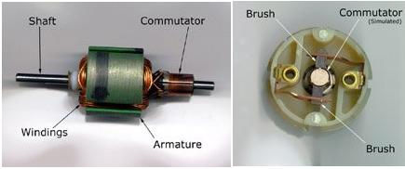
The (Simple) Physics of a DC Motor
From electrical to rotational energy
Two permanent magnets are placed next to an electromagnet whose inductor connectors (a pair of brushes) are placed in contact with a split-ring commutator.
With this simple configuration shown in these pictures (real DC motors may have more than 2 sectors), as the electromagnet is moving its polarity is changing and the shaft may keep rotating.

Slide 27
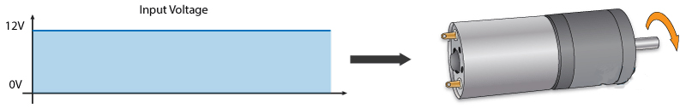
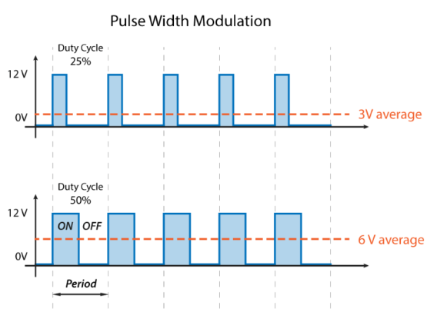
In order to have different speeds on a DC motor, it’s sufficient to provide different values of voltage. But how can we provide such values when or microcontrollers only support Digital Outputs (i.e. all or nothing)?
With Pulse Width Modulation (PWM)
PWM is a technique which permits to adjust the average value of the voltage that’s going to the electronic device by turning on and off the power at a fast rate. The average voltage depends on the duty cycle.
Almost every Arduino module and shield comes with at least one GPIO which supports PWM.
Controlling the Speed with PWM:

Slide 28
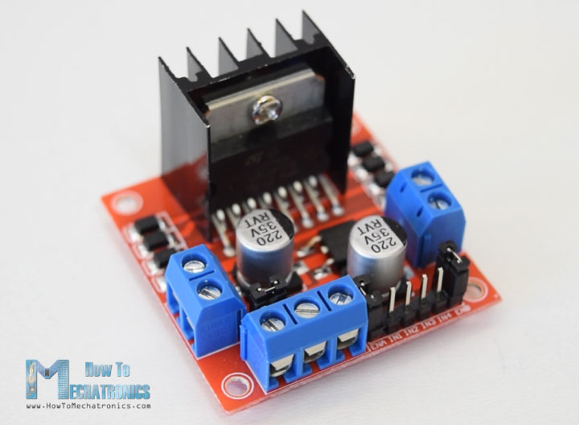
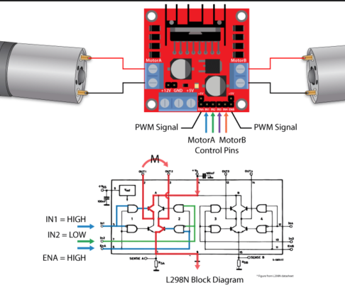
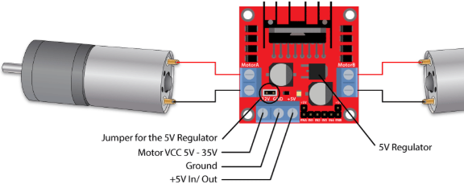
One module to control them all...
In order to control both the PWM ‘voltage’ and the wheels’ direction (inverting the voltage means inverting the rotation), the most common module in amateur projects is the L298N.
This module supports voltages between 5 and 35V, with a peak current up to 2A.
Here we show a single module capable of controlling two wheels at the same time, but we actually make use of a bigger module with 2xL298N and some support circuits for controlling also Servo Motors.

Slide 29
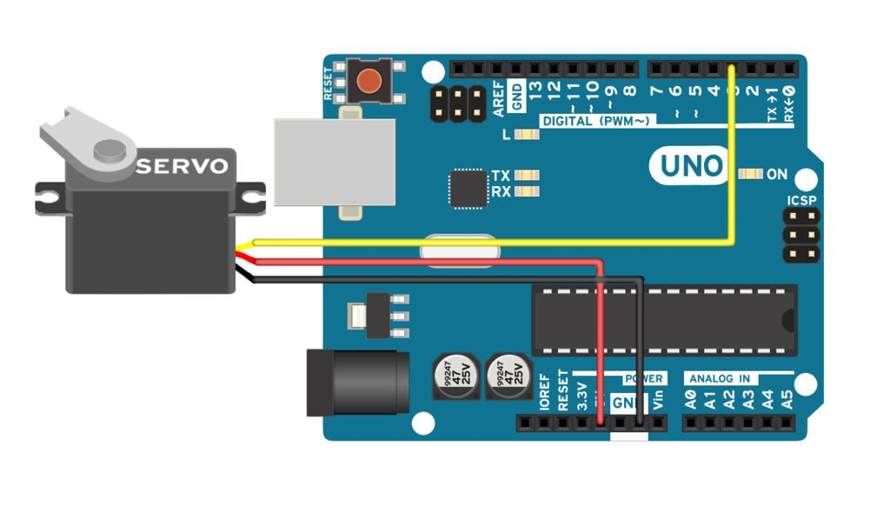
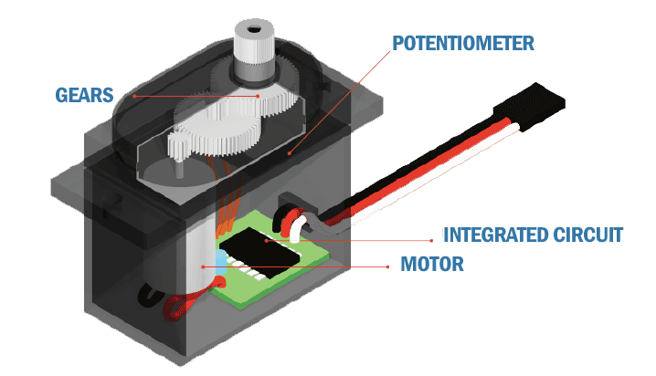
Servomotors
Perfect control over angular position
Servomotor is a term used to refer to motors suitable for use in a closed-loop control system (e.g. a system where the control action from the controller is dependent on feedback from the process).
In our contest, our servomotor is a rotary actuator whose orientation can be precisely controlled with a simple PWM signal.
This allows us to make the Echo Locator of the car ‘look around’ at precise degrees.

Slide 30
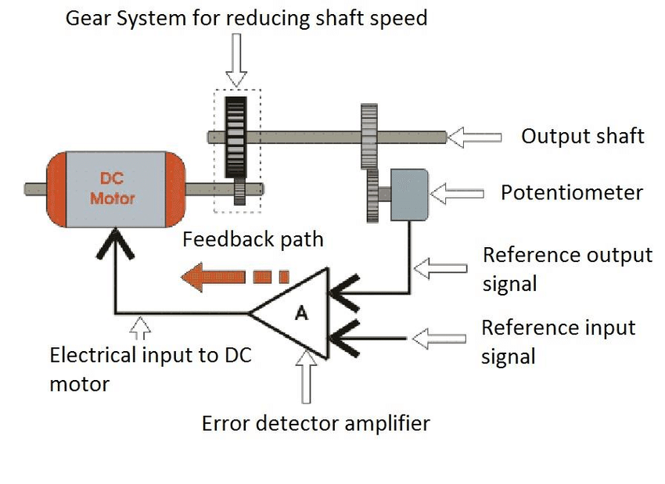
Servomotors
ServoMotors: how do they work?
Servomotors are a simple combination of a DC motor, a potentiometer and a closed-loop control circuit.
The DC motor is attached by gears to control the output shaft orientation. When the shaft of the motor is at the desired position, the power supplied to the motor is stopped by the op-amp in the closed-loop control circuit.
The motor's speed is proportional to the difference between its actual position and desired position. This is called proportional control.

Slide 31
Putting everything together:
The ESP-13 shield
(odissey)

Slide 32
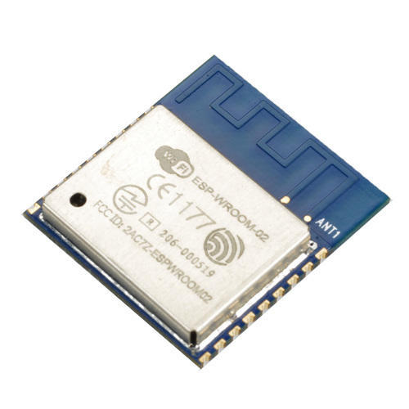
The ESP shield
The ESP-13 is an Arduino Uno shield whith an embedded ESP-WROOM02 module.
The ESP-WROOM02 by Espressif is an integrated WiFi 802.11 b/g/n module designed for providing wireless connection to embedded systems, it’s powered by an ESP8266EX chip, a 32 bit low-power microcontroller, with 2MB of onboard memory and can be programmed with the Arduino IDE.
ESP-13 by Jaycar offers a breakout for all the pins of the ESP-WROOM02, an onboard voltage divider for powering the ESP-WROOM02 itself (Arduino offers a 5V line but ESP8266 uses 3.3V signals both for powering and GPIO communication) and a level shifter for the logic signals coming from and to the Arduino.
Or at least it should…

Slide 33
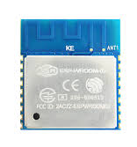
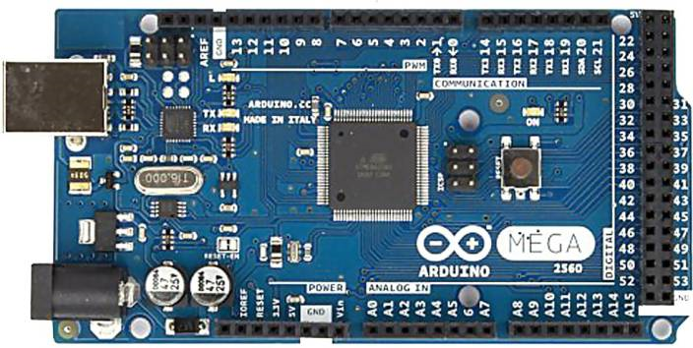


The ESP shield
The RX and TX pins on the shield, corresponding to the pins 0 (RX) and 1 (TX) in the Arduino layout were actually switched, rendering impossible to use the shield in its intended configuration.
RX
TX
RX0
TX0
RX
TX
RX0
TX0

Slide 34
The ESP shield
Possible solutions:
Trash the whole thing
Tempting but not very cost-effective
Fix the onboard traces
Scrape the soldermask to expose the traces
cut the traces in two different points
run two jumper wires
Time-consuming
We didn’t have any small-diameter wire laying around that day
Just connect it using jumper wires
Quickest solution

Slide 35
The ESP shield
5V > 5V
GND > GND
RX 1 > TX0
TX 1 > RX0

Slide 36
The ESP shield
5V (ARDUINO)
3.3V
(ESP8266)
The onboard voltage regulator should convert the 5V power provided by arduino and convert it to a 3.3V line that can be used by the ESP8266
BUT…
The serial lines on the ESP8266 should also use 3.3V logic: we need a level shifter so that 5V signals from the Arduino can be translated to 3.3V for the ESP8266 and vice versa.
or do we?

Slide 37


The ESP shield
I remembered seeing some years a go a post on hackaday.com discussing wether the ESP8266 was actually 5V tolerant: people were using the ESP8266 serial lines with 5V logic without consequences
In order to have more valid sources to support this assertion. I decided to look more into it.

Slide 38
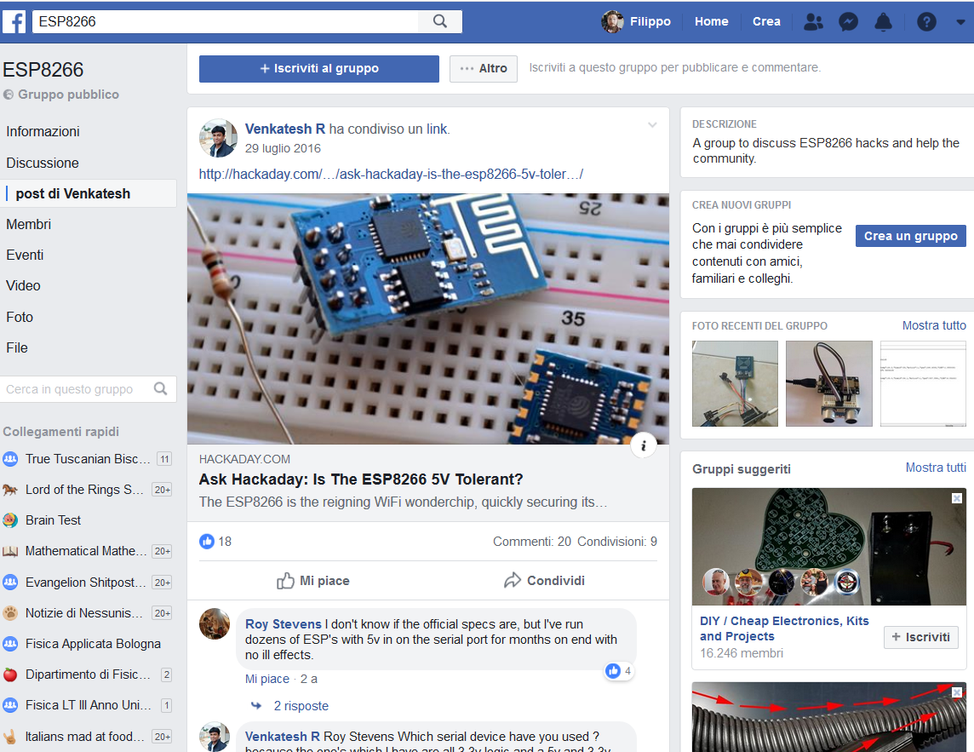

The ESP shield
With the benediction of the Espressif CEO himself we could connect the ESP8266 to 5V logic without any worries

Slide 39
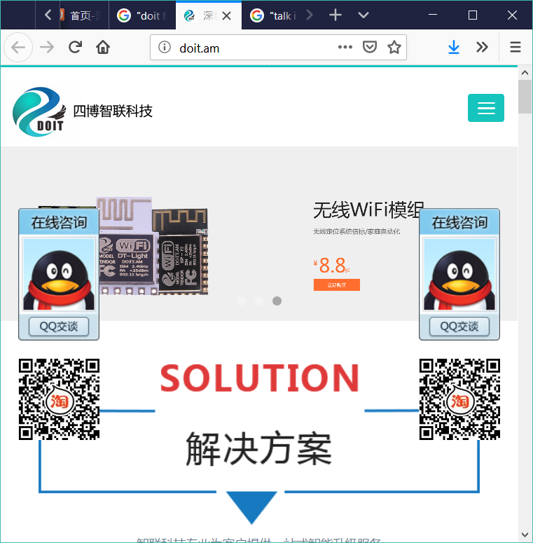

The ESP shield
Can we finally use the ESP8266?
Nope
To be programmed using the Arduino IDE, the ESP8266 needs the AT Firmware by Espressif
Turns out the ESP8266 came pre-flashed with the chinese DOIT firmware

Slide 40
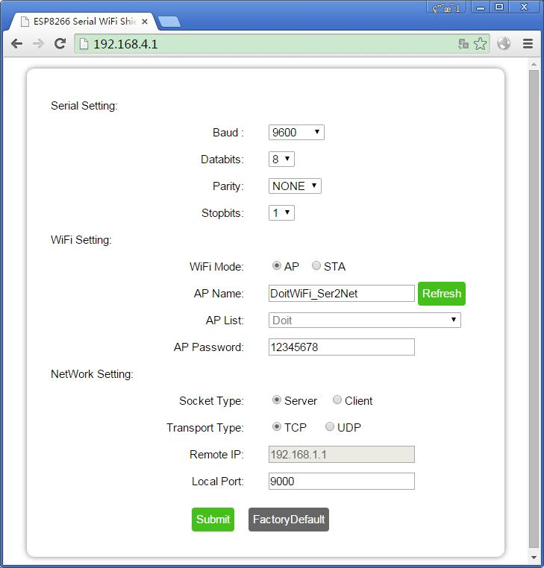
The ESP shield
It’s not a bad firmware per-se, but it does only one thing (and actually does it well):
Configures the ESP8266 to act as an access point
Starts a webserver on 192.168.4.1 and streams a nice config page from there
Listens on the serial connection
Encapsules every received sequence in a TCP package and streams it on the webserver.
But that’s not what we need!

Slide 41

The ESP shield
DOIT configuration
our configuration
turn right!
turn right!
* turns right *

Slide 42
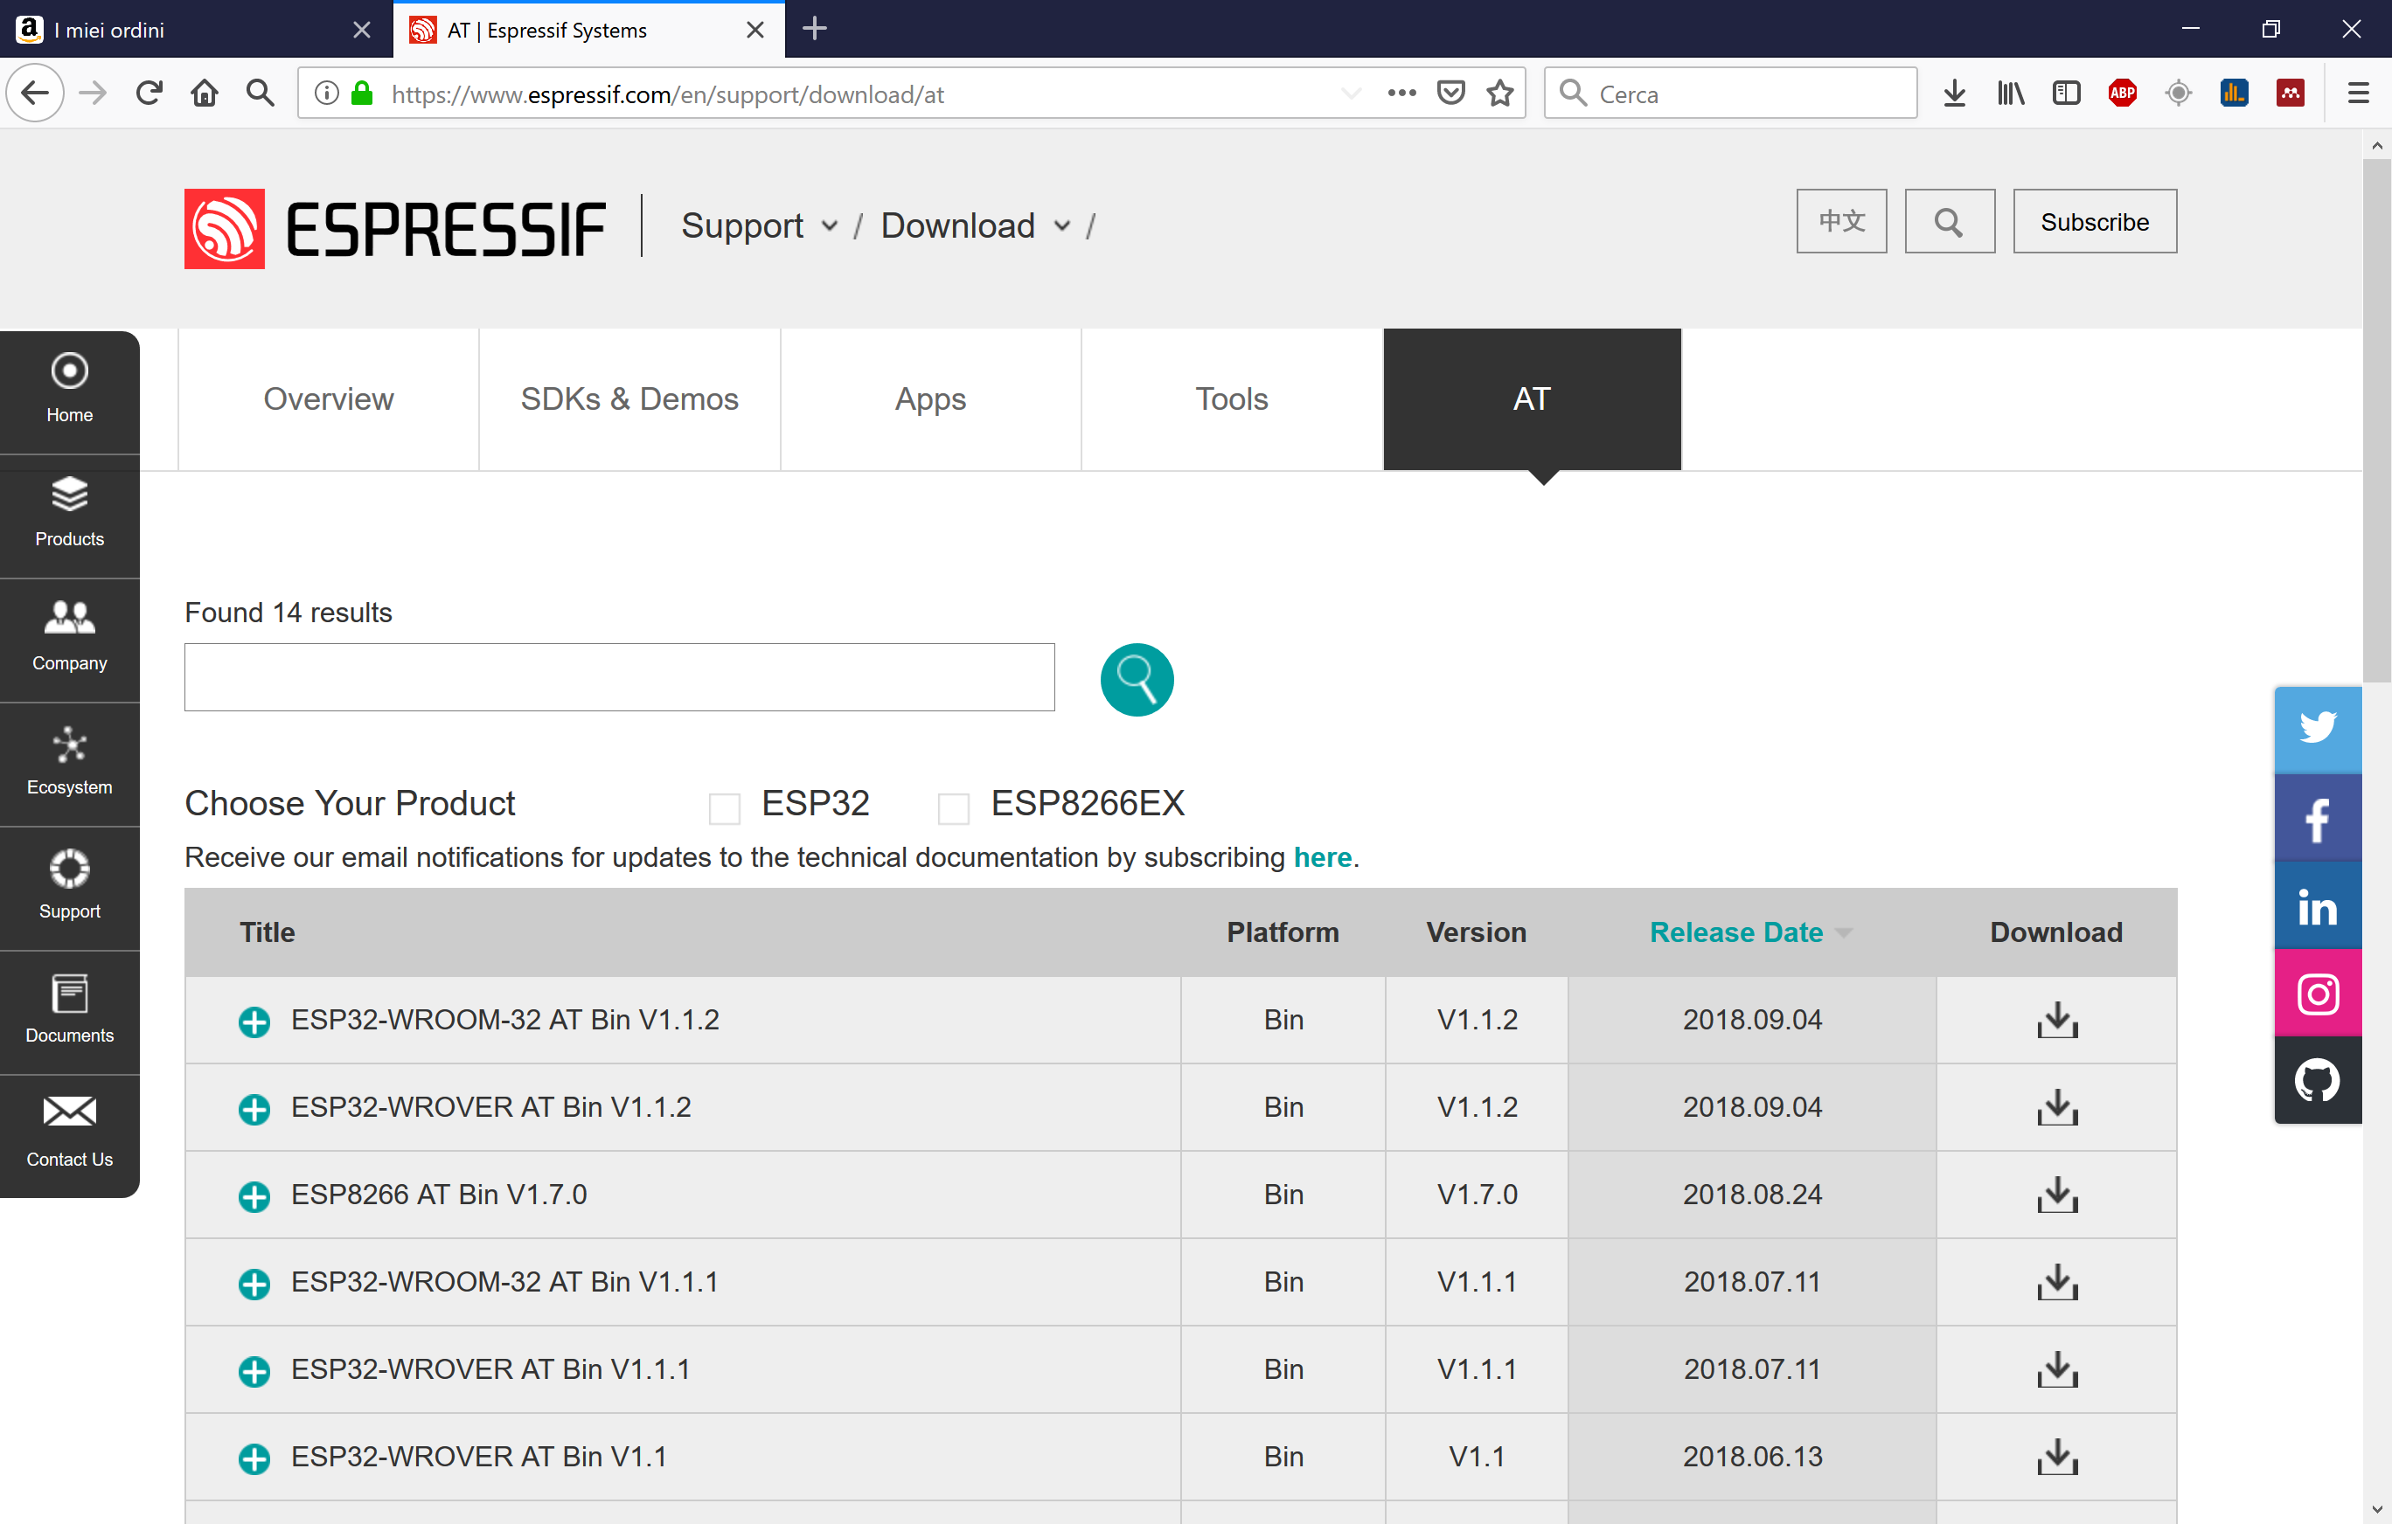
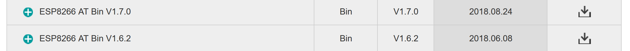
The ESP shield
We need to flash the AT firmware:
It can be downloaded from the Espressif website at www.espressif.com along with the firmware flashing tool. So far seems easy!
but...

Slide 43
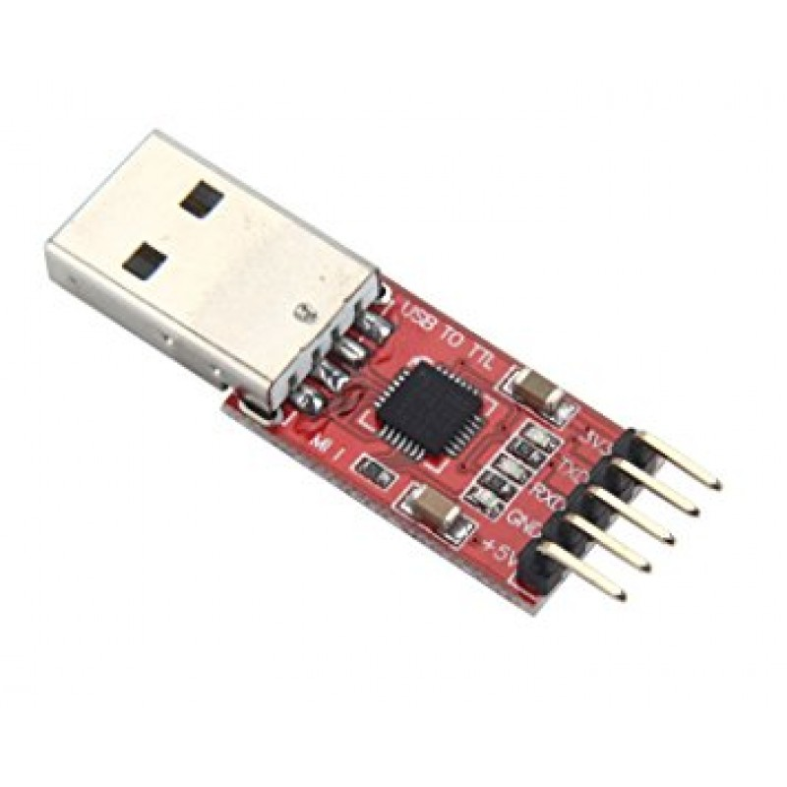

The ESP shield
How do we connect the ESP8266 to the pc?
The ESP-WROOM02 doesn’t have its own USB-UART hardware, like the Arduino has, so it needs some kind of USB-TTL interface to be programmed, they’re quite cheap to purchase on any online shop...
...but is there another way?
We can use what we already have: Arduinos!
Arduino has it’s own USB-TTL interface to program the onboard Atmel ATMEGA328P, we can use that instead of purchasing a USB-TTL adapter.
How to use what we have?

Slide 44
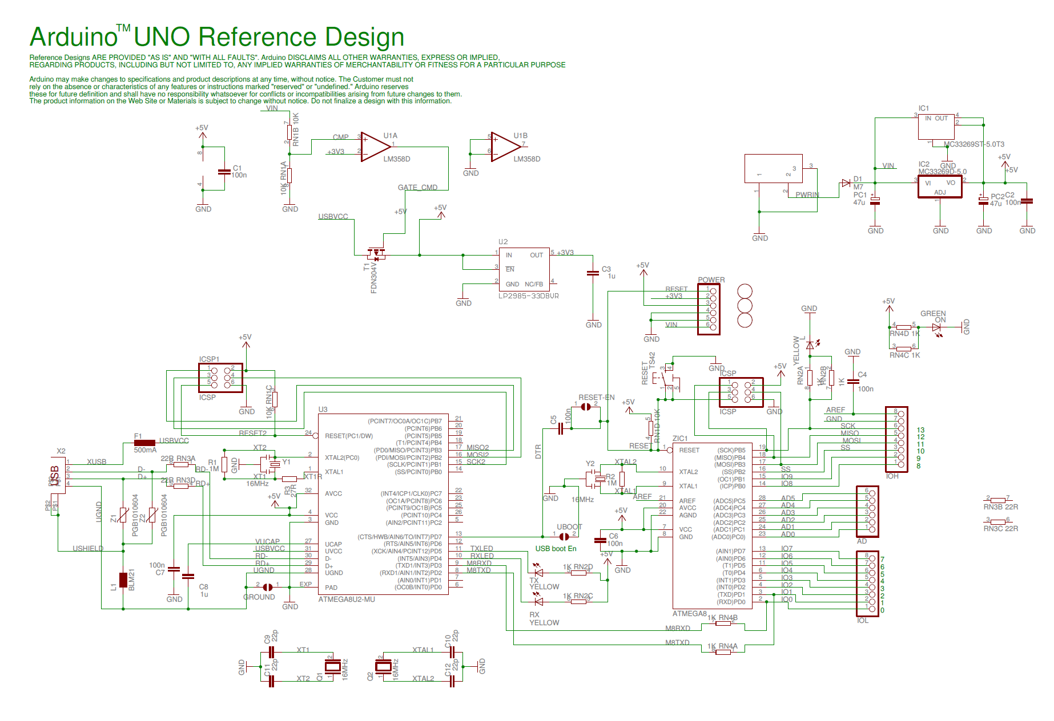
The ESP shield
How do we connect the ESP8266 to the pc?
Let’s take a look at the Arduino uno schematics:
If we ignore the power-related parts of the interface...
We find the interesting parts:
The ATMEGA controller
The USB-TTL adapter

Slide 45
The ESP shield
How do we connect the ESP8266 to the pc?
The D+ and D- differential data lines reach the USB-TTL interface:
we can then decide to program the chip talking via the ISP programmer or using the serial, interacting with the ATMEGA328P’s bootloader

Slide 46
The ESP shield
How do we connect the ESP8266 to the pc?
The PD0 and PD1 pins of the ATMEGA328P are exposed as pin 0 and 1 on the Arduino board!
That solves part of our economical problems as we probably won’t have to buy a USB-TTL adapter!
The ESP8266 can be flashed from serial:
when the GPIO0 pin is held on LOW(GND) it will execute a serial bootloader which will receive the programs we want to flash from the Espressif Flash Tool.

Slide 47
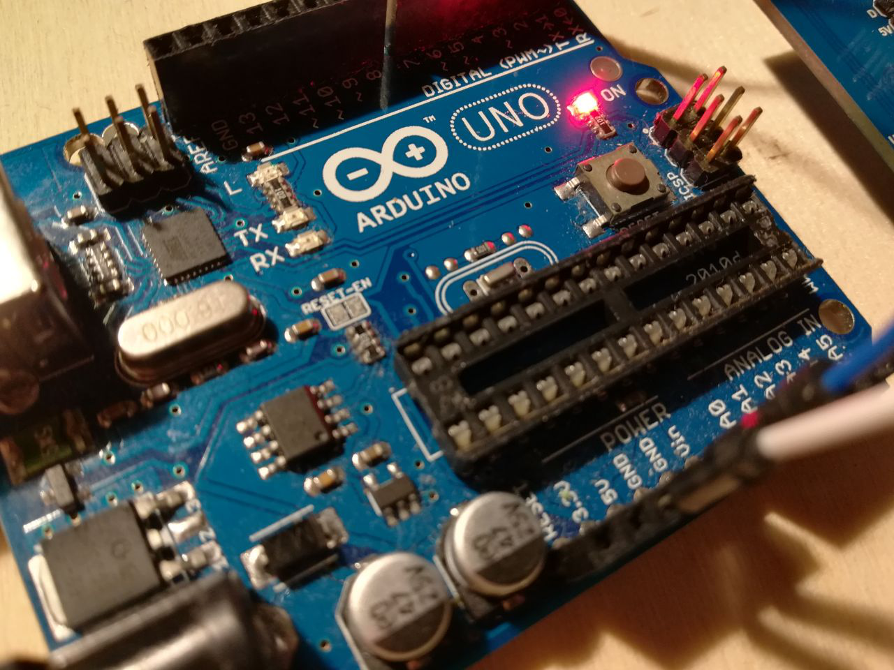

The ESP shield
How do we connect the ESP8266 to the pc?
We now need a practical method to adapt the USB-TTL interface to our needs:
Method 1: The Literal No-brainer
Remove the ATMEGA328P from its socket
Power up the ESP8266 connecting the 3.3V line to the Arduino 5V through the voltage regulator as we did before
Connect the RX and TX pins of the ESP8266 to the Arduino
We’re not trying to communicate with a the arduino but are trying to talk directly to the USB-TTL chip, the right connection scheme now is RX0 -> RX, TX0 -> TX!
That looks good if we have a socketed controller like in the Uno case, but what about the Mega?

Slide 48
The ESP shield
How do we connect the ESP8266 to the pc?
But the Mega has a soldered ATMEGA2560 controller that might be a little bit impractical to remove.
Method 2: The Sleeping Beauty
If we can’t remove the controller itself we can just silence it when we need to speak with the ESP8266 by grounding it’s RESET signal.
Run a jumper wire between RESET and GND
Proceed exactly as Method 1

Slide 49


The ESP shield
Now we can finally proceed to flash the AT firmware on the ESP-WROOM02.
The AT firmware comes with a bunch of files to be flashed at different positions in the memory map

Slide 50


The ESP shield
The documentation by Espressif helps to choose which .bin is flashed to which memory address as memory can be organized differently from package to package

Slide 51


The ESP shield
Just define your memory map flashing schedule and a few parameters like
the communication port you’re using
the baud rate
various characteristics of the ESP8266 package can be detected automatically by the tool
it can take a while to figure out the correct settings and the correct firmware version to use for your specific chip.

Slide 52

The ESP shield
If the firmware is flashed correctly, when sending the command AT+GMR? on serial the ESP8266 should reply with the current firmware version.
Using serial commands you can change settings without needing to reflash a program everytime.

Slide 53

The ESP shield
We can now develop a program for the ESP8266 module directly in the Arduino IDE! (it requires some extensions available on the Arduino website) using the same C++ language you use for normal Arduino programming:
We set up a webserver wich streams a simple webpage which we use to control the car.
To flash your program you just need the same setup we used to flash the firmware (Arduino IDE only flashes a memory region allocated to program execution).

Slide 54

The ESP shield
Of course, when everything works, something unexpected happens.
And we fried everything
To put the ESP8266 in programming mode you need to short the D0 pin to ground: if the chip is powered in this configuration it will start a bootloader instead of the flashed program.
After repeating the same operation at least 10 times, we accidentally shorted a different pin to ground.
the VCC.
This short circuit fried the poor controller…

Slide 55

The ESP shield
Option #1: trash it and replace it
and change it with a more reasonable board, like the NodeMCU, that has its own USB UART hardware.
Option #2: the hard way
Order just the ESP8266 controller, without any additional hardware, and substitute it to the fried one.
guess which way we went...
(we actually ordered both, but it was just a week before Christmas and the NodeMCU parcel was LOST, until a day after we took the hard way)

Slide 56

The ESP shield

Slide 57

The ESP shield

Slide 58

The ESP shield

Slide 59

The ESP shield

Slide 60

The ESP shield

Slide 61

The ESP shield
We had to slightly change the flashing settings because the new chip was a different revision (took some trial and error to figure out)
But it all ended well!

Slide 62

Putting everything together:
The Software
https://github.com/filippocastelli/uolli

Slide 63


The Software
We tried to keep things as simple as reasonably possible, so we decided to cut down all the software paraphernalia to only a single tool:
The Arduino IDE
The Arduino IDE can be found on
www.arduino.cc/en/main/software
pre-compiled for a variety of platforms and it’s the ideally the only thing you need to start programming on the Arduino platform.

Slide 64

The Software
You don’t even need to install it to start coding! You can use a web-based Arduino Create! IDE available on the Arduino webpage.
Arduino Create!
https://create.arduino.cc/editor

Slide 65


The Software
Anatomy of and Arduino Sketch:
Arduino can be programmed in a special C / C++ dialect that requires absolutely 0 learning effort if you’ve already programmed in C/C++
As a matter of fact every time that you compile an Arduino Sketch it’s actually translated to C/C++ code and compiled using the AVR version of the g++ compiler with the compiler we’re all familiar with, called avr-g++
https://www.arduino.cc/en/tutorial/sketch

Slide 66
The Software
Anatomy of and Arduino Sketch:
Any sketch has to implement at least two functions:
the setup() function:
I’s the first part of the program and it’s called only once when the Arduino wakes up.
the loop() function:
as the name suggests it’s looped over and over until the thermodynamic death of the universe
You may want to use setup() for setting up all you need in terms of IO pin settings and then run the actual program in loop()
https://www.arduino.cc/en/tutorial/sketch

Slide 67
The Software
Anatomy of and Arduino Sketch:
You can also divide your code and function definitions in multiple files without caring for linking as long as:
The main sketch has the same name of the directory it’s in
The other files are in the same directory
https://www.arduino.cc/en/tutorial/sketch

Slide 68

The Software
Our Arduino Sketch:
The main file is extremely simple:
Just some imports for IRremote.h, Servo.h and our configuration file conf.h
In the setup() we call specific setup routines we’ve written for everything we need and open two serial connections
One on TX0,RX0 for usb debugging
One on TX1, RX1 for communication with the ESP8266
https://github.com/filippocastelli/uolli

Slide 69
The Software
Our Arduino Sketch:
The loop() calls two different functions:
one for receiving the commands
Either from Serial (from the ESP8266) or from the IR receiver.
one for the actual driving
Let’s take a look at the configuration file
https://github.com/filippocastelli/uolli

Slide 70
The Software
Our Arduino Sketch:
The loop() calls two different functions:
one for receiving the commands
Either from Serial (from the ESP8266) or from the IR receiver.
one for the actual driving
https://github.com/filippocastelli/uolli

Slide 71


The Software
Our Arduino Sketch:
Just overvieweing a couple of things in the code, we can see that the init_xyz() we called in the setup() look similar to each other: we use the pinMode() command to set some specific GPIO pins (described in the conf.h) to act either as INPUT or OUTPUT.
Other functions use the previously set pins to send digital signals (HIGH/LOW) (5V/0V) with functions like digitalWrite() that’s used to define a state of a GPIO pin when set as OUTPUT
https://github.com/filippocastelli/uolli

Slide 72


The Software
Our Arduino Sketch:
For when we need different voltages, we can theoretically implement our PWM routine, but this has a big disadvantage: the output signal depends on what the processor is doing and we can’t focus on other operations than producing the PWM signal
To overcome this, Arduino has some PWM-enabled pins that can be controlled using the analogWrite() function without consuming precious controller cycles:
We can indicate the duty cycle as an int between 0 and 255
https://github.com/filippocastelli/uolli

Slide 73

The Software
Our Arduino Sketch:
The guide step is done without using too many delays because we can’t afford to leave the controller idle a long period of time if we want it to be reasonally reactive: the longest routines have to be implemented using a time reference that’s given by the millis() function
millis() returns the number of milliseconds that have passed from the controller’s bootup.
We can use it to start timers and to control the duration of a certain operation.
https://github.com/filippocastelli/uolli

Slide 74

The Software
Our Arduino Sketch:
The automatic mode implements really simple logics based on the perceived distances between the car and surrounding objects: these are measured using the HSR04 module.
We’ve written a simple routine to drive the module: we first tell the HSR04 to send a signal on the transducer with a digitalWrite() for 15 ms, then wait for an echo.
If there’s an echo, the HSR04 sends an HIGH signal whose duration is the same as the time between the signal start and the echo receiving
https://github.com/filippocastelli/uolli

Slide 75
The Software
Our Arduino Sketch:
We can measure the length of a pulse using the pulseIn() function: if it’s set on HIGH it waits for the argument pin to switch from LOW to HIGH and, waits for it to return to LOW and then returns the HIGH time duration.
https://github.com/filippocastelli/uolli

Slide 76
The Software
Our Arduino Sketch:
The rest of the Arduino code is quite self explanatory and going in detail would take too much time.
You may also want to check the ESP8266 code that basically creates an HTML page with some interactive buttons, detects the button presses and sends values to serial depending on which button has been pressed.
https://github.com/filippocastelli/uolli

Slide 77
In Conclusion:
What have we learned from this?
Making something actually work can be rewarding.
It’s more rewarding when it doesn’t catch fire.
You shouldn’t buy the cheapest part if you want to finish you projects on time.
Documentation is everything: if you don’t know what you’re doing you should always go for the most documented solution.
If you buy the cheapest parts, you will (have to) learn a lot in the process
But, at least in the electronics world, you should also consider investing in a Chinese course.
Look online when you have a problem: someone probably had it before you.
It’s ok to be cheap/lazy: justifying your bad habits can lead you to some new knowledge.
Don’t short power rails a week before Christmas: replacements for your fried controllers may take forever to arrive.

Slide 78
Thanks for your attention!
https://github.com/filippocastelli/uolli
Filippo Maria Castelli, MSc
castelli@lens.unifi.it
github.com/filippocastelli
Carlo Emilio Montanari, MSc
carlo.montanari5@unibo.it
github.com/carlidel

